Slide 2
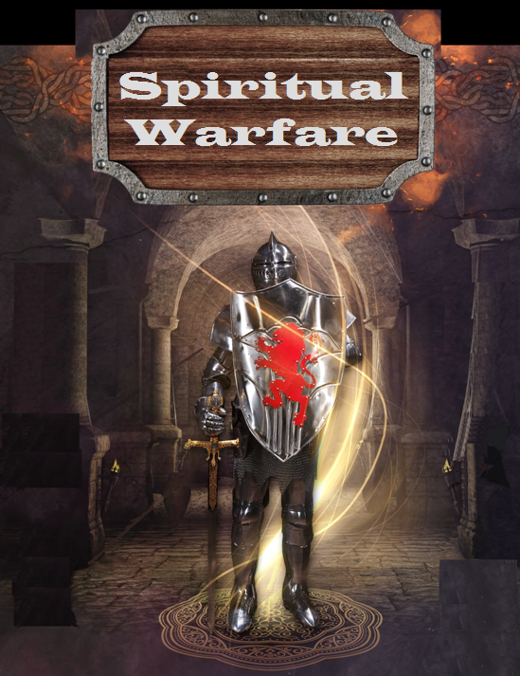

Slide 3
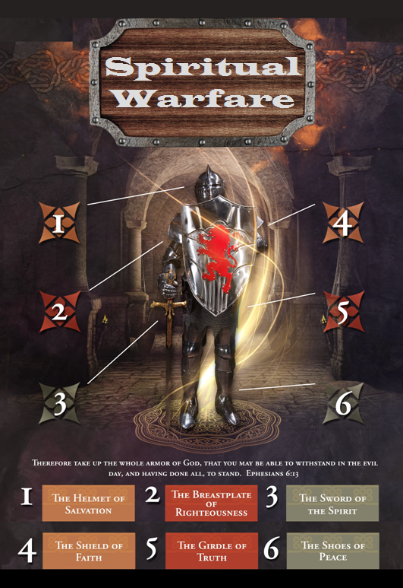

Slide 4
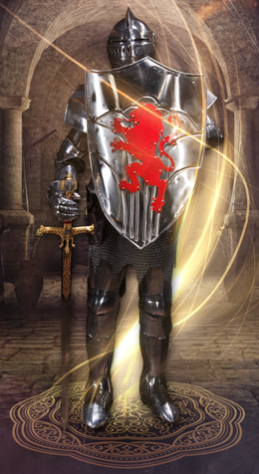
SPIRITUAL WARFARE
TEMPTATION
01 09-01 A Brief Look at Ephesians 6:12-18
Temptation’s 3 forms (1Jn. 2:15-17)
02 09-08 Temptations of Gen. 3 and Mt. 4; Jas 1
03 09-15 Scriptures explaining… The Lust of the Eyes
04 09-22 Scriptures explaining… The Lust of the Flesh
05 09-29 Scriptures explaining… The Pride of Life

Slide 5
SPIRITUAL WARFARE
DEFENSIVE WEAPONS
06 10-06 Defensive Weapons: Girdle and Breastplate
07 10-13 Defensive Weapons: Shoes and Shield
08 10-20 Defensive Weapons: Helmet and Sword

Slide 6
SPIRITUAL WARFARE
OFFENSIVE WEAPONS
09 10-27 Offensive Weapons: Prayer
10 11-03 Offensive Weapons: Praise
11 11-10 Offensive Weapons: Preaching
12 11-17 Offensive Weapons: Posture
13 11-24 Victory! (The Basis of Our Victory)

Slide 7
SPIRITUAL WARFARE
OFFENSIVE WEAPON OF PREACHING
A Weapon of Attack
Some Important Considerations
Five Things to Know about Preaching
Some Scriptures Concerning Preaching
All verses are from the
New American Standard Bible unless otherwise cited.

Slide 8
SPIRITUAL WARFARE
OFFENSIVE WEAPON OF PREACHING
A Weapon of Attack:
2Timothy 4:1-4
Reprove (to reprimand or censure)
Rebuke (sharp disapproval or criticism)
Exhort (to strongly encourage or urge)

Slide 9
SPIRITUAL WARFARE
OFFENSIVE WEAPON OF PREACHING
Some Important Things Concerning Preaching:
1. The solemnity of the charge.
2. The charge is to preach the Word.
3. Be “in season and out of season.”
4. Warning not to accommodate error.

Slide 10
SPIRITUAL WARFARE
OFFENSIVE WEAPON OF PREACHING
Five Things to Know about Preaching:
1. It is a wonderful privilege.
2. It demands loyalty.
3. It is a calling wrapped up in failure.
4. It means being diligent in prayer.
5. It means sometimes you get it wrong.

Slide 11
SPIRITUAL WARFARE
THE OFFENSIVE WEAPON OF PREACHING
Scriptures concerning preaching:
Matthew 13:41; 24:14
Mark 1:38,39; 16:15
Luke 3:18
Acts 8:4; 8:12; 8:35; 10:42; 17:18
Romans 1:15; 16:25-26
1Corinthians 1:17; 1:21-24
Galatians 1:8-9
Colossians 1:25

Slide 12
SPIRITUAL WARFARE
NEXT WEEK:
THE FULL ARMOR OF GOD
(Eph. 6:18-20)
OFFENSIVE WEAPONS…
Posture (Lifestyle)
blank

