Slide 3
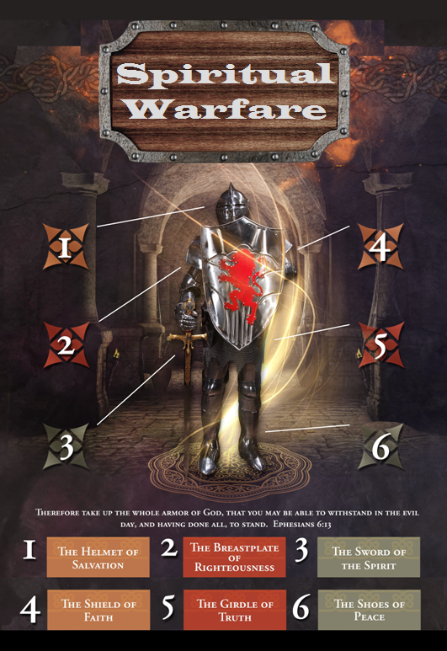

Slide 4
SPIRITUAL WARFARE
TEMPTATION
01 09-01 A Brief Look at Ephesians 6:12-18
Temptation’s 3 forms (1Jn. 2:15-17)
02 09-08 Temptations of Gen. 3 and Mt. 4; Jas 1
03 09-15 Scriptures explaining… The Lust of the Eyes
04 09-22 Scriptures explaining… The Lust of the Flesh
05 09-29 Scriptures explaining… The Pride of Life

Slide 5
SPIRITUAL WARFARE
DEFENSIVE WEAPONS
06 10-06 Defensive Weapons: Girdle and Breastplate
07 10-13 Defensive Weapons: Shoes and Shield
08 10-20 Defensive Weapons: Helmet and Sword

Slide 6
SPIRITUAL WARFARE
OFFENSIVE WEAPONS
09 10-27 Offensive Weapons: Prayer
10 11-03 Offensive Weapons: Praise
11 11-10 Offensive Weapons: Preaching
12 11-17 Offensive Weapons: Posture
13 11-24 Victory! (The Basis of Our Victory)

Slide 7
SPIRITUAL WARFARE
THE HELMET AND SWORD
The Helmet of Salvation
The Sword of the Spirit (the Word of God)
blank
All verses are from the
New American Standard Bible unless otherwise cited.

Slide 8
SPIRITUAL WARFARE
THE HELMET OF SALVATION
Scriptures concerning the Salvation:
Exodus 15:2; 2Samuel 22:3; 22:47
Psalms 3:8; 37:39; 51:12; 62:2; 96:2; 119:174
Micah 7:7; Habakkuk 3:18
Acts 4:12; 2Corinthians 6:2
Philippians 1:28; 2Timothy 3:15
Hebrews 5:9
1Peter 1:5,9; 2Peter 3:15k

Slide 9
SPIRITUAL WARFARE
THE SWORD OF THE SPIRIT
Scriptures concerning the Word of God:
Matthew 4:4; 15:6
Luke 8:11; 11:28
Acts 4:31; 6:2; 6:7
2Corinthians 2:17; 4:2
1Thessalonians 2:13
Titus 2:5
Hebrews 13:7
1Peter 1:23

Slide 10
SPIRITUAL WARFARE
THE UNPROTECTED AREA
Never turn your back on the devil.
Scriptures concerning endurance:
Matthew 10:22; 24:13
Luke 21:19
John 6:27
1Corinthians 10:13; 13:7
2Thessalonians 1:4
2Timothy 2:12; 4:5
Hebrews 12:1

Slide 11
SPIRITUAL WARFARE
THE UNPROTECTED AREA
We are not always able to protect our own back.
Scriptures concerning brother keeping:
Romans 12:10,16; 13:8; 14:19; 15:7
1Corinthians 12:25
Galatians 5:13,26; 6:2
Ephesians 4:2; 4:32; Colossians 3:13
1Thessalonians 5:11
Hebrews 3:12-13; 10:24-25
James 5:16; 1Peter 4:8-9
1John 4:7,11-12

Slide 12
SPIRITUAL WARFARE
NEXT WEEK:
THE FULL ARMOR OF GOD
(Eph. 6:18-20)
OFFENSIVE WEAPONS…
Prayer
blank

