Slide 3
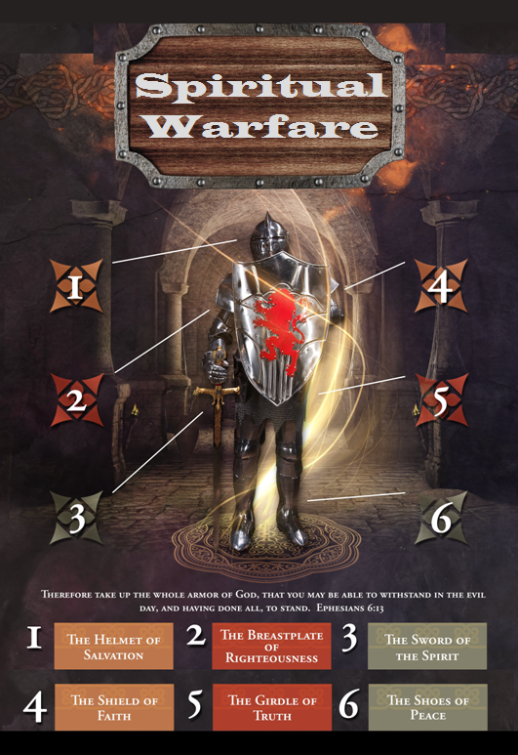

Slide 4
SPIRITUAL WARFARE
TEMPTATION
01 09-01 A Brief Look at Ephesians 6:12-18
Temptation’s 3 forms (1Jn. 2:15-17)
02 09-08 Temptations of Gen. 3 and Mt. 4; Jas 1
03 09-15 Scriptures explaining… The Lust of the Eyes
04 09-22 Scriptures explaining… The Lust of the Flesh
05 09-29 Scriptures explaining… The Pride of Life

Slide 5
SPIRITUAL WARFARE
DEFENSIVE WEAPONS
06 10-06 Defensive Weapons: Girdle and Breastplate
07 10-13 Defensive Weapons: Shoes and Shield
08 10-20 Defensive Weapons: Helmet and Sword

Slide 6
SPIRITUAL WARFARE
OFFENSIVE WEAPONS
09 10-27 Offensive Weapons: Prayer
10 11-03 Offensive Weapons: Praise
11 11-10 Offensive Weapons: Preaching
12 11-17 Offensive Weapons: Posture
13 11-24 Victory! (The Basis of Our Victory)

Slide 7
SPIRITUAL WARFARE
THE BOASTFUL PRIDE OF LIFE
Definitions
Old Testament Scriptures
New Testament Scriptures
blank
All verses are from the
New American Standard Bible unless otherwise cited.

Slide 8
SPIRITUAL WARFARE
THE BOASTFUL PRIDE OF LIFE
DEFINITIONS:
Hunting after honors, titles, and pedigrees; boasting of ancestry, family connections, great offices, honorable acquaintance, and the like (A.Clarke).
Thirsting after honor and applause (M.Henry).
The word here used means, properly, ostentation or boasting, and then arrogance or pride (Robinson).
blank

Slide 9
SPIRITUAL WARFARE
THE BOASTFUL PRIDE OF LIFE
DEFINITIONS:
It refers to whatever there is that tends to promote pride, or that is an index of pride, such as the ostentatious display of dress, equipage, furniture, etc. (A.Barnes).
A quick look at 1John 2:15-17.
1Corinthians 1:31
blank

Slide 10
SPIRITUAL WARFARE
THE BOASTFUL PRIDE OF LIFE
OLD TESTAMENTSCRIPTURES…
2Chronicles 32:26
Psalm 31:18
Proverbs 8:13
Jeremiah 13:9; 17:9
blank

Slide 11
SPIRITUAL WARFARE
THE LUST OF THE FLESH
NEW TESTAMENTSCRIPTURES…
Mark 7:21-23 (see Lk. 21:34; Phil. 4:7).
Luke 14:26-27 (see Rom. 12:9).
Romans 1:18-21; 7:22-23; 8:7; 12:1-2
1Corinthians 4:7; 10:13
2Corinthians 5:12
Galatians 5:17; Ephesians 2:1-2
2Timothy 2:4; Revelation 3:14-22
blank

Slide 12
SPIRITUAL WARFARE
NEXT WEEK:
THE FULL ARMOR OF GOD
(Eph. 6:10-17)
DEFENSIVE WEAPONS…
The Girdle and Breastplate
blank

