Slide 1
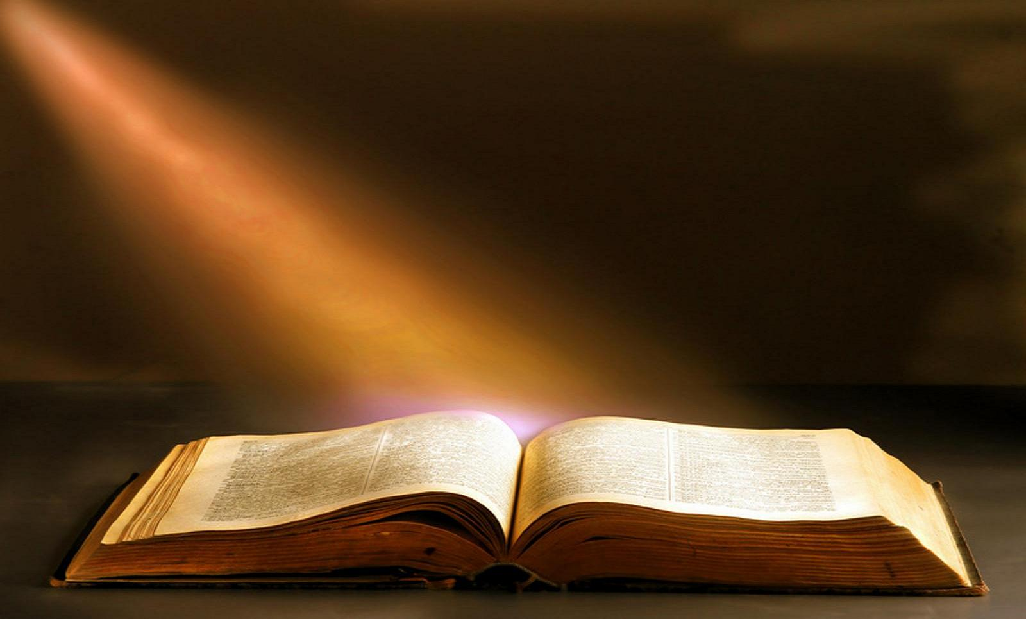
The 20 Greatest Chapters
in the Bible

Slide 2
The 20 Greatest Chapters in the Bible
Genesis 01
Exodus 20
Psalms 01
Psalms 23
Psalms 51
Psalms 119
Proverbs 31
Isaiah 40
Isaiah 53
Matthew 05
Matthew 06
Matthew 07
John 17
Acts 02
Romans 08
1Corinthians 13
1Corinthians 15
Ephesians 02
Hebrews 11
James 02

Slide 3
The 20 Greatest Chapters in the Bible
James, Chapter 02
FAITH IN ACTION!
1. Do Not Show Partiality (2:1-13).
2. A Dead Faith (2:14-17).
3. A Demonic Faith (2:18,19).
4. A Dynamic Faith (2:20-26).

Slide 4
The 20 Greatest Chapters in the Bible
James, Chapter 02
FAITH IN ACTION!
Do Not Show Partiality
1. Because of Christ (2:1-4).
2. Because of Grace (2:5-7).
3. Because of the Word (2:8-11).
4. Because of the Judgment (2:12,13).

Slide 5
The 20 Greatest Chapters in the Bible
James, Chapter 02
FAITH IN ACTION!
A Dead Faith (2:14-17).
See Matthew 7:21.
1. People with a dead faith substitute words for deeds.
2. People with a dead faith make faith an intellectual exercise.

Slide 6
The 20 Greatest Chapters in the Bible
James, Chapter 02
FAITH IN ACTION!
A Demonic Faith (2:18,19).
1. Showing faith by our works.
2. The faith of demons
is not atheistic or agnostic.

Slide 7
The 20 Greatest Chapters in the Bible
James, Chapter 02
FAITH IN ACTION!
A Dynamic Faith (2:20-26).
1. Is based on the word of God.
2. Involves the whole person.
3. Leads to action.
4. Two examples: Abraham & Rahab.

Slide 8
The 20 Greatest Chapters in the Bible
Summary
1. Genesis 01 = The beginning.
2. Exodus 20 = The Mosaic Covenant.
3. Psalm 01 = Blessed is the man…
4. Psalm 23 = The Good Shepherd.
5. Psalm 51 = Sorrow for sin.

Slide 9
The 20 Greatest Chapters in the Bible
Summary
6. Psalm 119 = The Glorious Word of God.
7. Proverbs 31 = The virtuous woman.
8. Isaiah 40 = Here is Your God!
9. Isaiah 53 = The Suffering Savior.
10. Matthew 05 = The Sermon on the Mount: True Righteousness

Slide 10
The 20 Greatest Chapters in the Bible
Summary
11. Matthew 06 = The Sermon on the Mount: True Worship
12. Matthew 07 = The Sermon on the Mount: True Judgment
13. John 17 = Jesus’ Prayer for Unity.
14. Acts 02 = The Church Begins!
15. Romans 08 = More Than Conquerors.

Slide 11
The 20 Greatest Chapters in the Bible
Summary
16. 1Cor. 13 = The Love Chapter.
17. 1Cor. 15 = The Resurrection.
18. Ephesians 02 = Grace and Peace.
19. Hebrews 11 = Living By Faith.
20. James 02 = Faith In Action.

Slide 12
The 20 Greatest Chapters
in the Bible

