Slide 1
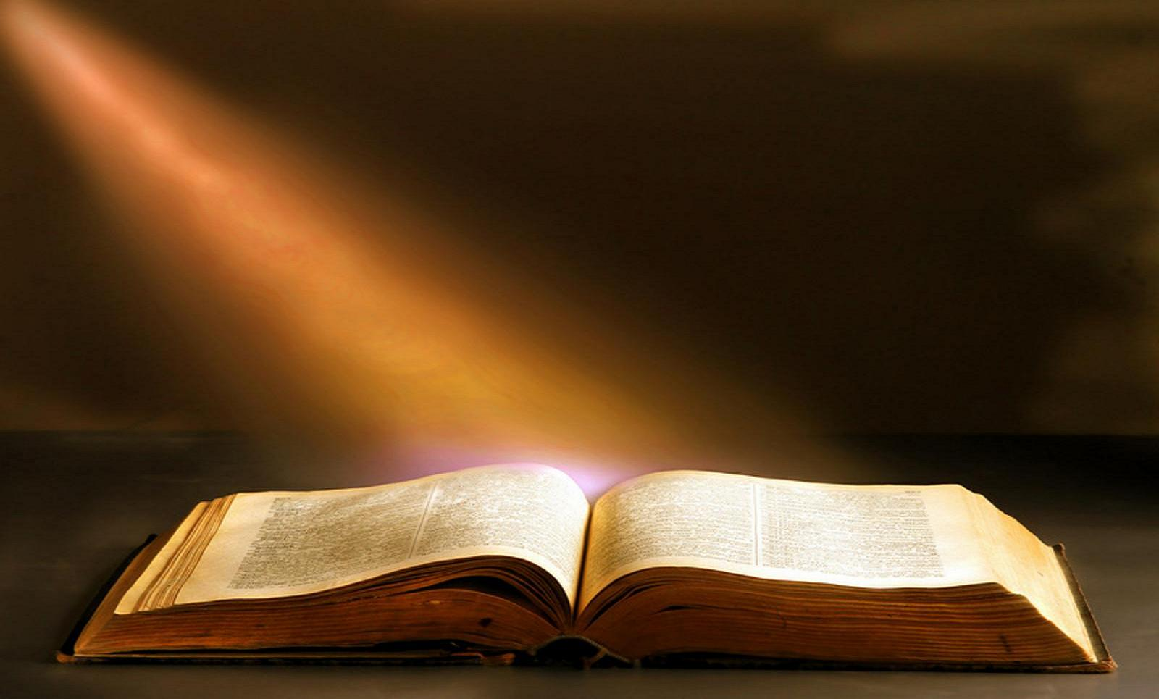
The 20 Greatest Chapters
in the Bible

Slide 2
The 20 Greatest Chapters in the Bible
Genesis 01
Exodus 20
Psalms 01
Psalms 23
Psalms 51
Psalms 119
Proverbs 31
Isaiah 40
Isaiah 53
Matthew 05
Matthew 06
Matthew 07
John 17
Acts 02
Romans 08
1Corinthians 13
1Corinthians 15
Ephesians 02
Hebrews 11
James 02

Slide 3
The 20 Greatest Chapters in the Bible
1Corinthians, Chapter 15
THE RESURRECTION
1. The Gospel of the Risen Christ (15:1-11).
2. Consequences of Denying (15:11-19).
3. Order of the Resurrection (15:20-28).
4. Implications of the Resurrection (15:29-49).
5. Events of the Resurrection Day (15:50-58).

Slide 4
The 20 Greatest Chapters in the Bible
1Corinthians, Chapter 15
THE RESURRECTION
The Gospel of the Risen Christ (15:1-11)
1. The good news of the resurrection.
2. Appearances of the resurrected Christ.
3. Paul’s special apostleship.

Slide 5
The 20 Greatest Chapters in the Bible
1Corinthians, Chapter 15
THE RESURRECTION
Consequences of Denying (15:12-19).
1. Some denied the doctrine.
2. Results of denying the doctrine.

Slide 6
The 20 Greatest Chapters in the Bible
1Corinthians, Chapter 15
THE RESURRECTION
The Order of the Resurrection (15:20-28).
1. Christ, the first fruits.
2. The resurrection order.
3. The last enemy is destroyed.

Slide 7
The 20 Greatest Chapters in the Bible
1Corinthians, Chapter 15
THE RESURRECTION
Implications of the Resurrection (15:29-56).
1. Baptism by proxy?
2. Suffering and sacrifices of the apostles.
3. Two questions asked and answered.

Slide 8
The 20 Greatest Chapters in the Bible
1Corinthians, Chapter 15
THE RESURRECTION
Events of the Resurrection Day (15:50-58).
1. A mystery.
2. The last events.
3. Because of the resurrection...
4. The admonition to the living.

Slide 9
The 20 Greatest Chapters in the Bible
1Corinthians, Chapter 15
THE RESURRECTION
Events of the Resurrection Day (15:50-58).
1. A mystery.
2. The last events.
a. The Lord shall descend from heaven.
b. There will be the sound of the last trumpet.
c. The dead shall be raised (both righteous and unrighteous).
d. The righteous dead shall go first to Jesus.
e. The living shall be changed and the righteous ones will follow those who had perished to Jesus.

Slide 10
The 20 Greatest Chapters in the Bible
1Corinthians, Chapter 15
THE RESURRECTION
Events of the Resurrection Day (15:50-58).
1. A mystery.
2. The last events.
3. Because of the resurrection...
a. The perishable puts on the imperishable.
b. The mortal puts on immortality.
c. Death is swallowed up in victory!
d. The sting of death is overcome.
e. The victory over sin is in Jesus Christ.

Slide 11
The 20 Greatest Chapters in the Bible
1Corinthians, Chapter 15
THE RESURRECTION
Events of the Resurrection Day (15:50-58).
1. A mystery.
2. The last events.
3. Because of the resurrection...
4. The admonition to the living.
a. Be steadfast (faithful).
b. Be immovable (say no to sin).
c. Be always abounding in the Lord’s work.

Slide 12
The 20 Greatest Chapters in the Bible
Ephesians, Chapter 02
Next week:
Ephesians, Chapter 02
Out of the Graveyard!
A. Sin’s Work Against Us (2:1-3).
B. God’s Work For, In and Through Us (2:4-10).
The Great Peace Mission
C. The Separation of the Gentiles (2:11,12).
D. The Reconciliation of the Gentiles (2:13-18).
E. The Unification of Jew and Gentile (2:19-22).

Slide 13
The 20 Greatest Chapters
in the Bible

