Slide 1
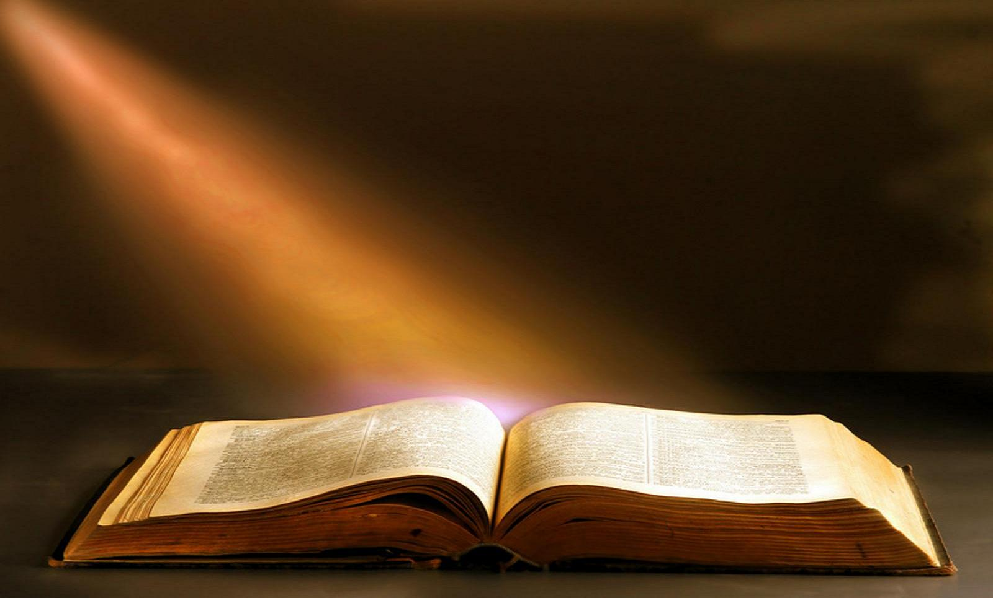
The 20 Greatest Chapters
in the Bible

Slide 2
The 20 Greatest Chapters in the Bible
Genesis 01
Exodus 20
Psalms 01
Psalms 23
Psalms 51
Psalms 119
Proverbs 31
Isaiah 40
Isaiah 53
Matthew 05
Matthew 06
Matthew 07
John 17
Acts 02
Romans 08
1Corinthians 13
1Corinthians 15
Ephesians 02
Hebrews 11
James 02

Slide 3
The 20 Greatest Chapters in the Bible
Matthew, Chapter 06
True Worship
1. …in Our Giving (Mt. 6:1-4).
2. …in Our Praying (Mt. 6:5-15).
3. …in Our Fasting (Mt. 6:16-18).
4. …in Our Use of Wealth (Mt. 6:19-34).

Slide 4
The 20 Greatest Chapters in the Bible
Matthew, Chapter 06
TRUE WORSHIP!
In Our Giving (6:1-4).
1. Giving alms.
2. Hypocrisy?
3. Wrong to give openly?
4. Motive and manner.

Slide 5
The 20 Greatest Chapters in the Bible
Matthew, Chapter 06
TRUE WORSHIP!
In Our Praying (6:5-15).
1. We must pray in secret before praying in public (6:6).
2. We must pray sincerely (6:7,8).
3. We must pray in God’s will (6:9-13).
4. We must pray with a forgiving spirit (6:14,15).

Slide 6
The 20 Greatest Chapters in the Bible
Matthew, Chapter 06
TRUE WORSHIP!
In Our Fasting (6:16-18).
1. Only one fast in OT (Lev. 23:27).
2. Jesus and the early Christians fasted.
3. True fasting is done in secret.

Slide 7
The 20 Greatest Chapters in the Bible
Matthew, Chapter 06
TRUE WORSHIP!
In Our Use of Wealth (6:19-34).
The NT does not magnify poverty or condemn the legitimate accumulation of wealth.
1. Enslavement (6:19-24).
2. Devaluation (6:25-30).
3. Loss of testimony (6:31-33).
4. Loss of joy (6:34).

Slide 8
The 20 Greatest Chapters in the Bible
Matthew, Chapter 07
Next week:
Matthew, Chapter 07
True Judgment
1. Our Judgment of Ourselves (Mt. 7:1-5).
2. Our Judgment of Others (7:6-20).
3. God’s Judgment of Us (7:21-29).

Slide 9
The 20 Greatest Chapters
in the Bible

