Slide 1
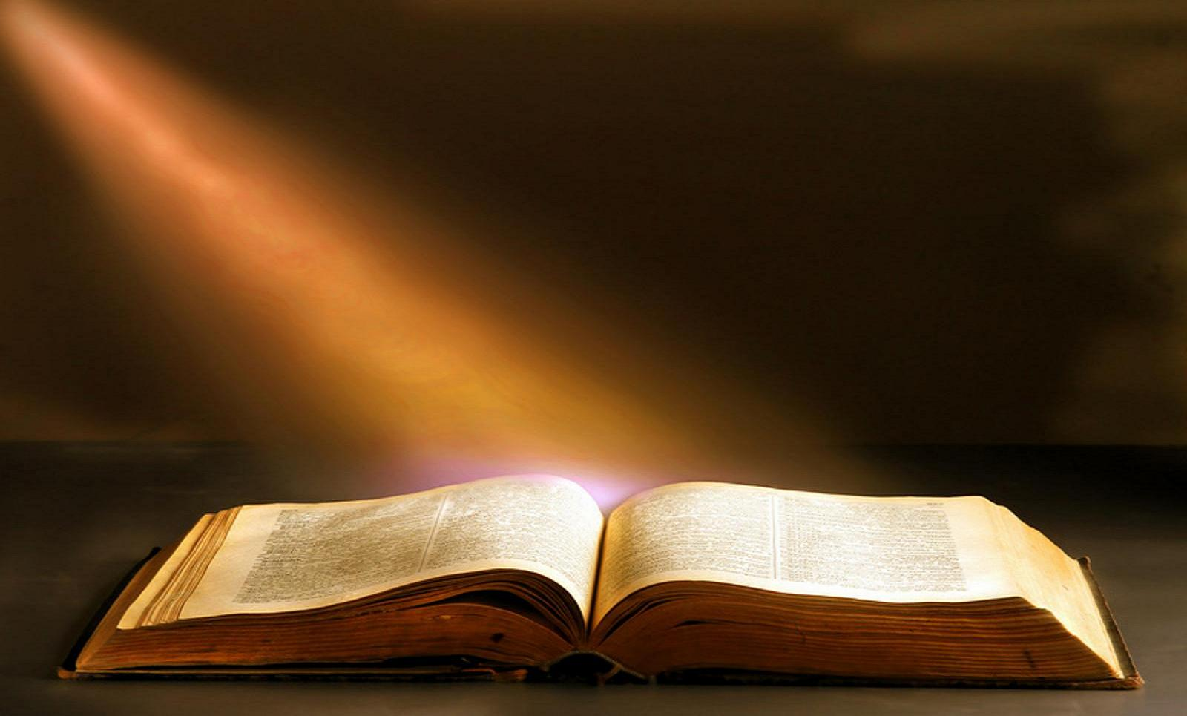
The 20 Greatest Chapters
in the Bible

Slide 2
The 20 Greatest Chapters in the Bible
Genesis 01
Exodus 20
Psalms 01
Psalms 23
Psalms 51
Psalms 119
Proverbs 31
Isaiah 40
Isaiah 53
Matthew 05
Matthew 06
Matthew 07
John 17
Acts 02
Romans 08
1Corinthians 13
1Corinthians 15
Ephesians 02
Hebrews 11
James 02

Slide 3
The 20 Greatest Chapters in the Bible
Isaiah, Chapter 53
Behold, My Servant
The Sin-Bearing Servant.
His Rejection.
His Redemption.
His Resignation.

Slide 4
The 20 Greatest Chapters in the Bible
Isaiah, Chapter 53
INTRODUCTION
The fact that these verses apply to Jesus is proved by Jn. 12:38, Mt. 8:17, Ac. 8:32-35, Mk. 15:28, Lk. 22:37, Rom. 10:16, and 1Pet. 2:24.
Isaiah 53 is quoted or referred to at least 85 times in the NT.
The prophecy begins with 52:13 (Christ’s exaltation), and the rest of the section deals with His humiliation.

Slide 5
The 20 Greatest Chapters in the Bible
Isaiah, Chapter 53
Behold, My Servant
THE SIN-BEARING SERVANT (Isa. 52:13-15).
The main figure in this paragraph is the suffering servant. It clear that the “servant” is Messiah, not some great person in Israel’s history, the prophet himself, Israel as a whole, or spiritual Israel.
Only Jesus did what is proclaimed of the servant in this context.

Slide 6
The 20 Greatest Chapters in the Bible
Isaiah, Chapter 53
Behold, My Servant
THE SERVANT’S REJECTION (Isa. 53:1-3).
The exiles respond, bemoaning, that very few had believed their message about the coming of the suffering servant.
The exiles found him unattractive, and the rest of mankind despised him. But the terrible appearance was due to the suffering endured because the exiles had sinned and failed to be Jehovah’s witnesses before the nations.

Slide 7
The 20 Greatest Chapters in the Bible
Isaiah, Chapter 53
Behold, My Servant
THE SERVANT’S REDEMPTION (Isa. 53:4-6).
Note the physical price that He paid:
1. Wounded, or pierced, referring to His death on the cross, pierced by nails (Jn. 19:37).
2. Bruised, or “crushed” as under a burden, the weight of sin which was laid on Him.
3. Chastised, or punished as though He had broken the law, with stripes from the scourging.

Slide 8
The 20 Greatest Chapters in the Bible
Isaiah, Chapter 53
Behold, My Servant
THE SERVANT’S REDEMPTION (Isa. 53:4-6).
Note the spiritual sufferings that He bore:
1. Our transgressions (v5,8), the rebellious and deliberate breaking of God’s Law.
2. Our iniquities (v5,6), the crookedness of our nature.
3. Our griefs and sorrows (v4), our calamities and the unhappy results of our sins.

Slide 9
The 20 Greatest Chapters in the Bible
Isaiah, Chapter 53
Behold, My Servant
THE SERVANT’S REDEMPTION (Isa. 53:4-6).
Note the physical sufferings that He bore.
Note the spiritual sufferings that He bore.
He died for us all. These verses are the very heart of the Gospel—“Christ died for our sins.”

Slide 10
The 20 Greatest Chapters in the Bible
Isaiah, Chapter 53
Behold, My Servant
THE SERVANT’S RESIGNATION (Isa. 53:7-9).
He was not treated justly; He was oppressed, harassed, treated roughly. Yet He did not complain or cry out. They mocked Him and pushed Him from one place to another, yet He was silent and meek as a lamb.
When men treat us unjustly (as they will because we follow Christ), we must glorify Christ by being yielded to His will.

Slide 11
The 20 Greatest Chapters in the Bible
Isaiah, Chapter 53
Behold, My Servant
THE SERVANT’S REWARD (Isa. 53:10-12).
The prophet praises Jehovah and his servant for being willing to make this sacrifice for the people’s sin and declares that it will bear fruit in due time.
Jehovah concludes the paragraph by proclaiming that, because His servant was willing to suffer and die, not only the Jews but also all men could be forgiven through the servant’s intercession.

Slide 12
The 20 Greatest Chapters in the Bible
Isaiah, Chapter 53
Behold, My Servant
ISAIAH 53 IN THE NEW TESTAMENT
Matthew 8:17 Acts 8:32-35
Mark 15:28 Romans 10:16
Luke 22:37 1Peter 2:24
John 12:38

Slide 13
The 20 Greatest Chapters in the Bible
Matthew, Chapter 5
Next week:
The Sermon on the Mount
Matthew, Chapter 5
What True Righteousness Is
How True Righteousness Comes
True Righteousness in Our Daily Lives

Slide 14
The 20 Greatest Chapters
in the Bible

