Slide 1
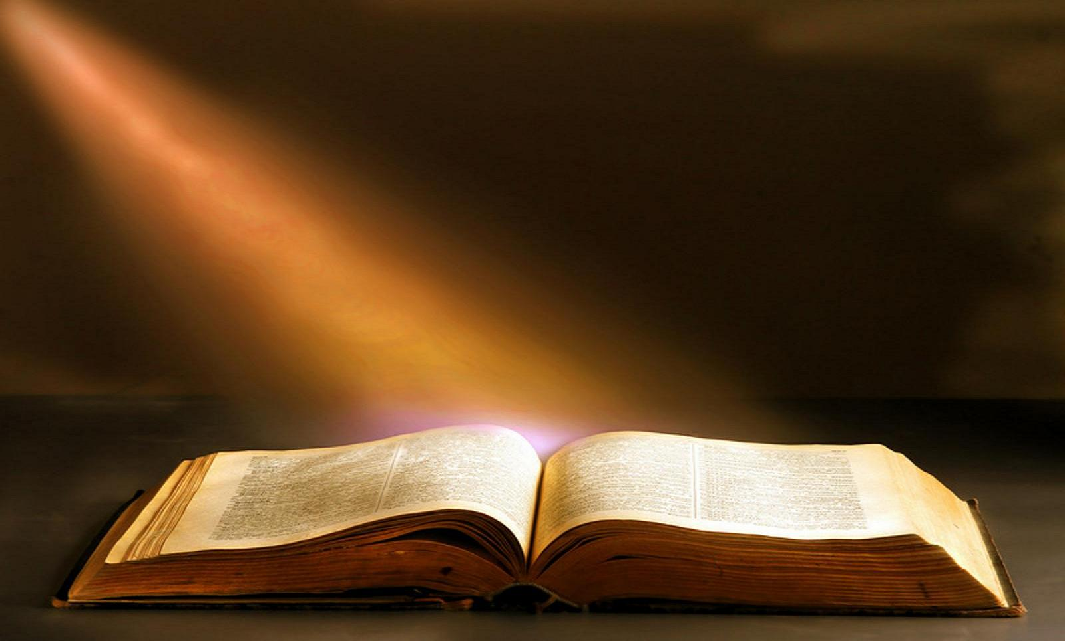
The 20 Greatest Chapters
in the Bible

Slide 2
The 20 Greatest Chapters in the Bible
Genesis 01
Exodus 20
Psalms 01
Psalms 23
Psalms 51
Psalms 119
Proverbs 31
Isaiah 40
Isaiah 53
Matthew 05
Matthew 06
Matthew 07
John 17
Acts 02
Romans 08
1Corinthians 13
1Corinthians 15
Ephesians 02
Hebrews 11
James 02

Slide 3
The 20 Greatest Chapters in the Bible
Isaiah, Chapter 40
HERE IS YOUR GOD!
God has incomprehensible power.
God has incomparable wisdom.
God has in-conquerable dominance over the nations.
God has incredible might to strengthen His people.

Slide 4
The 20 Greatest Chapters in the Bible
Isaiah, Chapter 40
INTRODUCTION
Isaiah 40 is one of the Bible’s most powerful chapters.
It tells us of some of the attributes of God in human terms which will allow us to better comprehend Him.
Too many times our image of God is too small.
This lesson will expand your concept of Jehovah God.

Slide 5
The 20 Greatest Chapters in the Bible
Isaiah, Chapter 40
HERE IS YOUR GOD!
GOD HAS IMCOMPREHENSIBLE POWER
Isaiah 40:12.
Isaiah 40:18-20.
Isaiah 40:22.
Isaiah 40:25,26.

Slide 6
The 20 Greatest Chapters in the Bible
Isaiah, Chapter 40
HERE IS YOUR GOD!
GOD HAS INCOMPARABLE WISDOM
Isaiah 40:13,14
Isaiah 40:23,27
Isaiah 40:28

Slide 7
The 20 Greatest Chapters in the Bible
Isaiah, Chapter 40
HERE IS YOUR GOD!
GOD HAS IN-CONQUERABLE DOMINANCE
OVER THE NATIONS
Isaiah 40:15
Isaiah 40:16,17
Isaiah 40:21
Isaiah 40:24

Slide 8
The 20 Greatest Chapters in the Bible
Isaiah, Chapter 40
HERE IS YOUR GOD!
GOD HAS INCREDIBLE MIGHT
TO STRENGTHEN HIS PEOPLE
Isaiah 40:29,30
Isaiah 40:31
Isaiah 40:1-5,9

Slide 9
The 20 Greatest Chapters in the Bible
Isaiah, Chapter 40
HERE IS YOUR GOD!
ISAIAH 40 IN THE NEW TESTAMENT
Isaiah 40:3-5… Mt. 3:3; Mk. 1:3; Lk. 3:4-6; Jn. 1:23
Isaiah 40:6-8… 1Pet. 1:24,25.
Isaiah 40:13… Rom. 11:34; 1Cor. 2:16.

Slide 10
The 20 Greatest Chapters in the Bible
Isaiah, Chapter 40
HERE IS YOUR GOD!
God has incomprehensible power.
God has incomparable wisdom.
God has in-conquerable dominance over the nations.
God has incredible might to strengthen His people.
There is none like God, He is in a class, position, and category by Himself.

Slide 11
The 20 Greatest Chapters in the Bible
Isaiah, Chapter 53
Next week:
Isaiah, Chapter 53
The Sin-Bearing Servant.
His Rejection.
His Redemption.
His Resignation.

Slide 12
The 20 Greatest Chapters
in the Bible

