Slide 2
Galatians 1:1-10
Paul Explains His Authority (1:1-5).
Paul Expresses His Anxiety (1:6-7).
Paul Exposes His Adversaries (1:8-10).

Slide 3
Galatians 1:11-24
Paul the Persecutor (1:11-14).
Paul the Believer (1:15-16b, 24).
1. God did it (1:15a-16a).
2. God did it by grace (1:15b).
3. God did it through Christ (1:16a).
4. God did it for the sake of others (1:16b).
5. God did it for His glory (1:24).
Paul the Preacher (1:16c-23).
1. He went to Arabia and Damascus (1:17).
2. He finally visited Jerusalem (1:18-20).
3. He returned home to Tarsus (1:21-23).

Slide 4
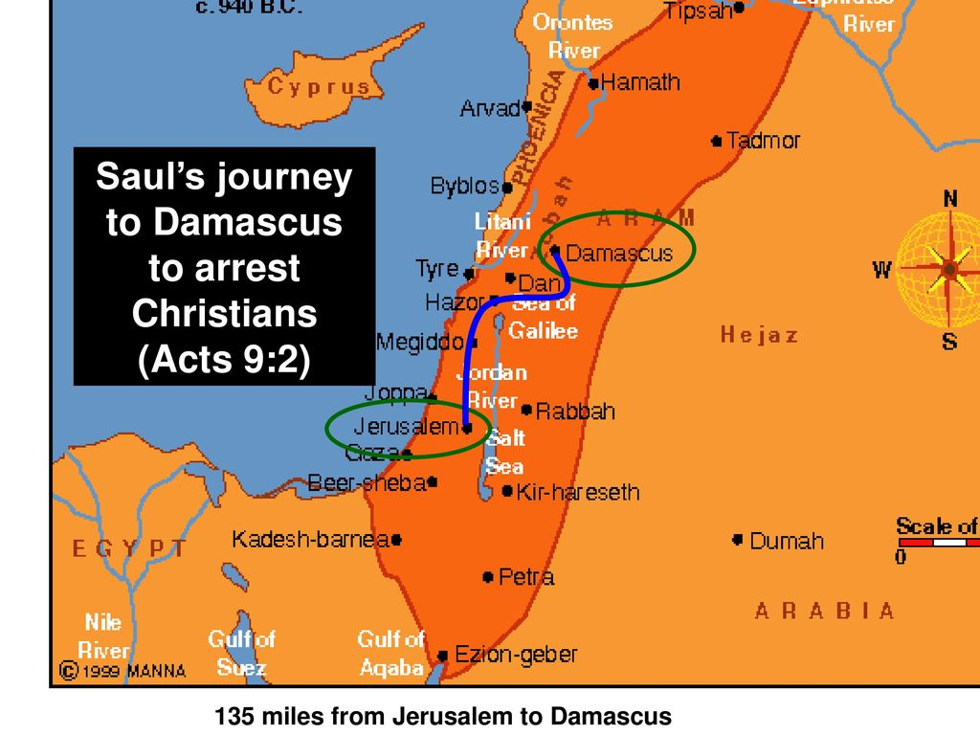

Slide 5
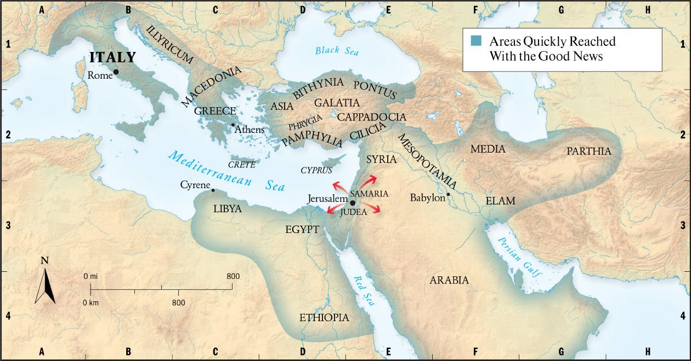

Slide 6
Galatians 1:11-24
Paul the Persecutor (1:11-14).
Paul the Believer (1:15-16b, 24).
1. God did it (1:15a-16a).
2. God did it by grace (1:15b).
3. God did it through Christ (1:16a).
4. God did it for the sake of others (1:16b).
5. God did it for His glory (1:24).
Paul the Preacher (1:16c-23).
1. He went to Arabia and Damascus (1:17).
2. He finally visited Jerusalem (1:18-20).
3. He returned home to Tarsus (1:21-23).

Slide 7
Applications and Discussion Questions
Applications:
1. In reviewing Paul’s conversion in Galatians, what parallels can you draw with your conversion?
2. What things did you have to lay down in order to become a Christian?
3. Share how you believe God is being glorified in your life.

Slide 8
Applications and Discussion Questions
Discussion Questions:
1. Do you think some brethren today are “set apart from their mother's womb”?
2. Why do you think Paul mentions being with Peter for 15 days?
3. List some blessings that come to mind by the phrase, “in Christ.”

